Slide 1
Intro to
Deep
Learning
NSDC MEC

Slide 2
Deep Learning (DL) is a special kind of Machine Learning that uses something called neural networks to learn.
If ML is like teaching a kid by showing examples, DL is like giving the kid a giant brain made of layers and layers of “thinking parts” so they can figure out really complicated things.

Slide 3
What is a Neural Network?
Inspired by the human brain.
Neuron: A simple unit that processes input and produces output.
Layers:
Input layer — Takes data in.
Hidden layers — Process and extract patterns.
Output layer — Produces the prediction or classification.

Slide 4
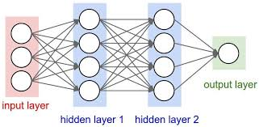

Slide 5
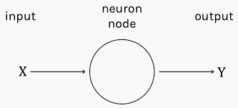

Slide 6
How Neural Networks Work?
Input Data → Fed into the network.
Weights & Biases → Adjust how important each input is.
Activation Functions → Decide if a neuron “fires” or not.
Forward Propagation → Data flows layer by layer to produce output.
Loss Function → Measures how wrong the output is.
Backpropagation → Adjusts weights to improve accuracy.

Slide 7
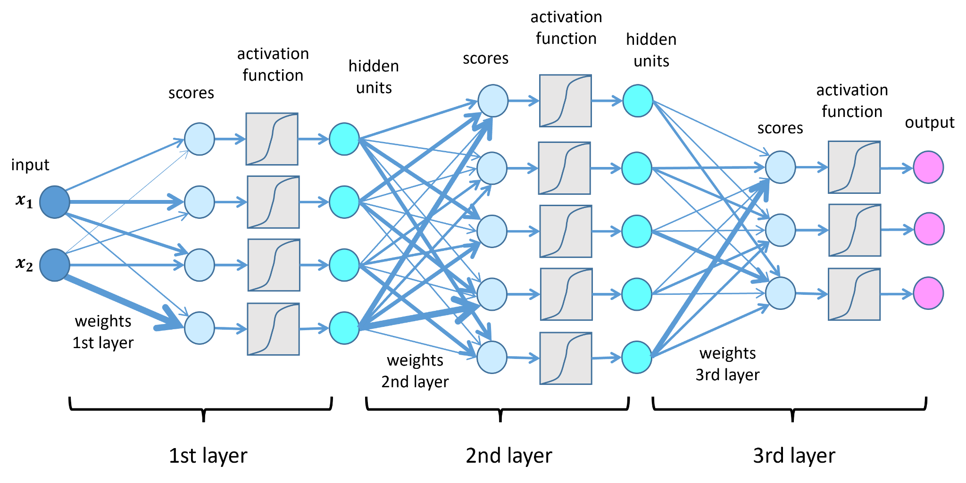

Slide 8
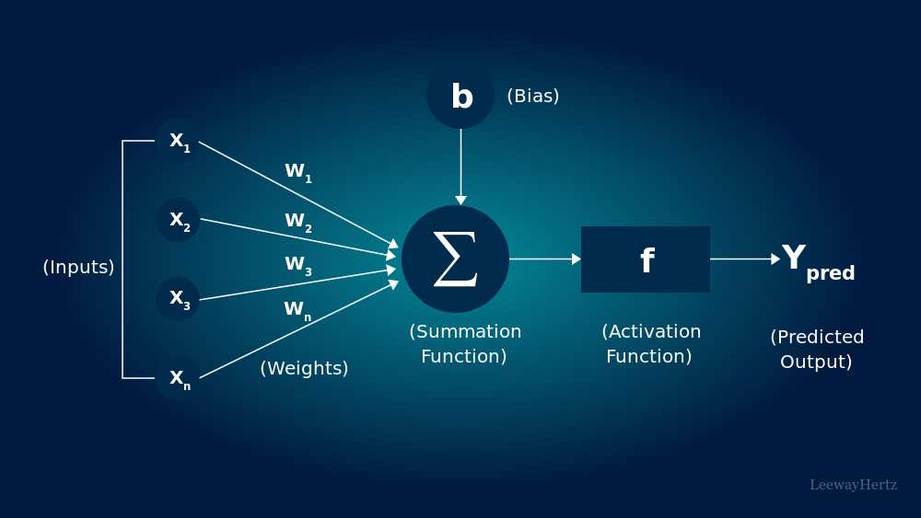

Slide 9
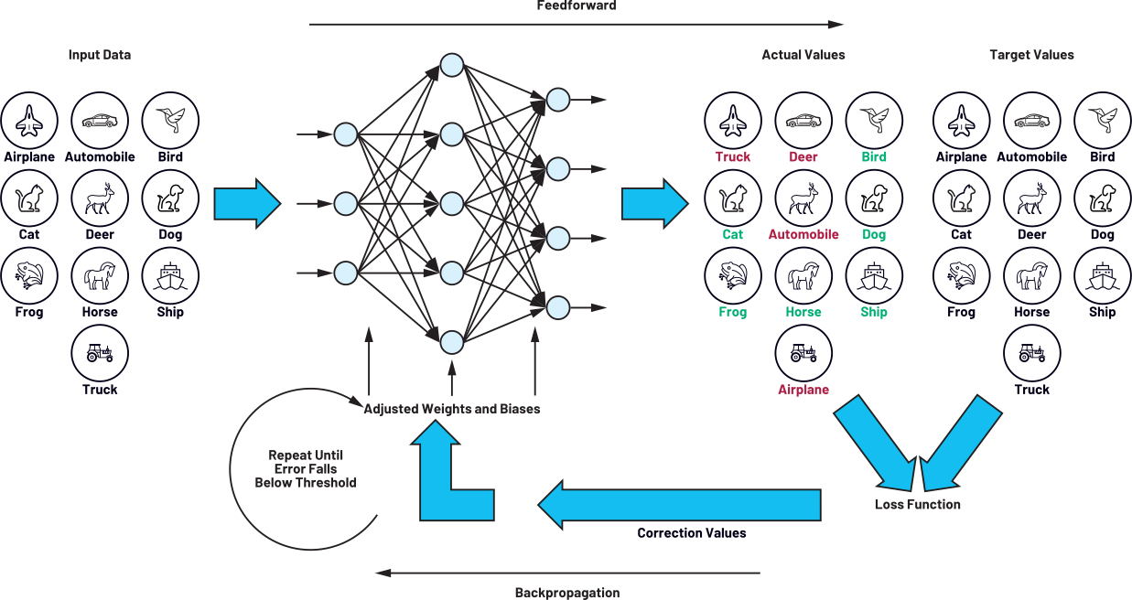

Slide 10
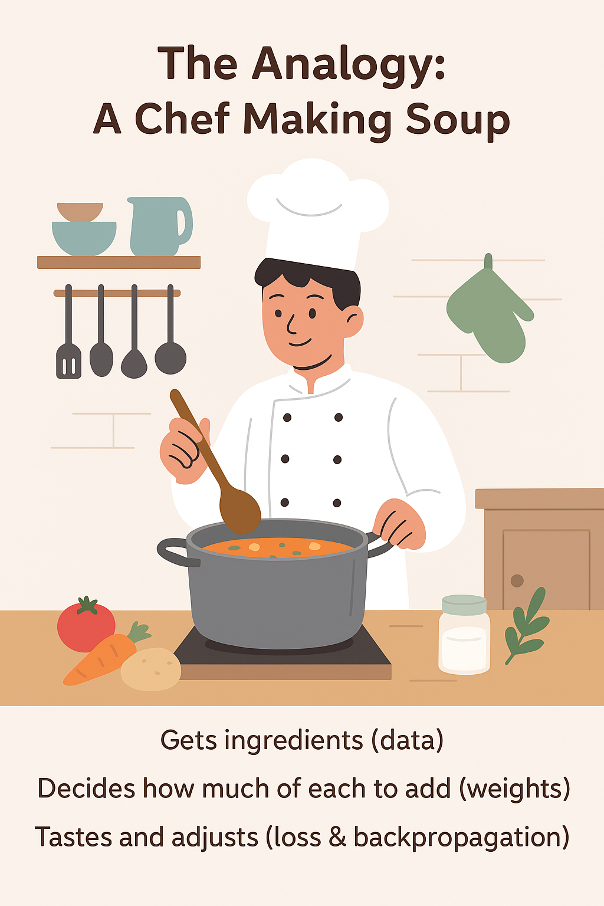

Slide 11
Analogy: A Chef Making Soup
Imagine a chef making soup:
Gets ingredients (data)
Decides how much of each to add (weights)
Tastes and adjusts (loss & backpropagation)

Slide 12
Step 1: Input Data
Neural Network: Numbers, images, or text go in as inputs. Chef Analogy: Ingredients (carrots, salt, water) go into the pot.
Each ingredient is a “feature” of the dish.
Step 2: Weights & Biases
Neural Network: Weights decide importance of each input. Bias adjusts the result. Chef Analogy: Chef decides how much salt, pepper, or carrots to add.
Too much salt → bad taste (wrong weight).

Slide 13
Step 3: Activation Functions
Neural Network: Decides if a neuron should “fire” (pass signal forward).
Chef Analogy: Chef tastes and decides if a flavor is strong enough to matter.
If flavor isn’t noticeable, ignore it.
Step 4: Forward Propagation
Neural Network: Data flows through layers until output is produced.
Chef Analogy: Ingredients mix, flavors combine, soup reaches final taste.

Slide 14
Step 5: Loss Function
Neural Network: Calculates how far the output is from the correct answer. Chef Analogy: Chef compares the soup’s taste to the “perfect recipe” taste.
Big difference → high “loss.”
Step 6: Backpropagation
Neural Network: Adjusts weights to reduce future errors. Chef Analogy: Chef adds more salt, less pepper, or adjusts ingredients for next try.
Repeat until soup matches perfect taste.

Slide 15
Applications of Deep Learning
Computer Vision: Image classification, object detection, medical imaging.
Natural Language Processing: Chatbots, translation, sentiment analysis.
Speech Recognition: Virtual assistants, transcription.
Autonomous Systems: Self-driving cars, robotics.

Slide 16
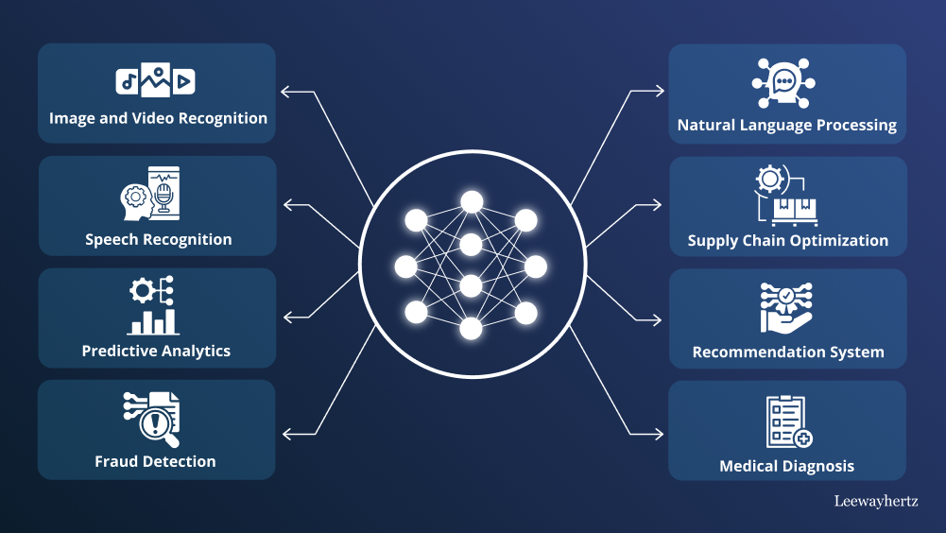

Slide 17
Challenges in Deep Learning
Requires huge amounts of labeled data.
High computational cost (GPUs, TPUs).
Can be a “black box” (hard to interpret).
Risk of overfitting.

